Slide 1

Forecasting Return on Ads Spend to Guide Daily Ad Decisions
Team Normalizers
Fahima Alizada
Marco Capoccia
Dheeraj Shetty
Sahaj Kaur

Slide 2
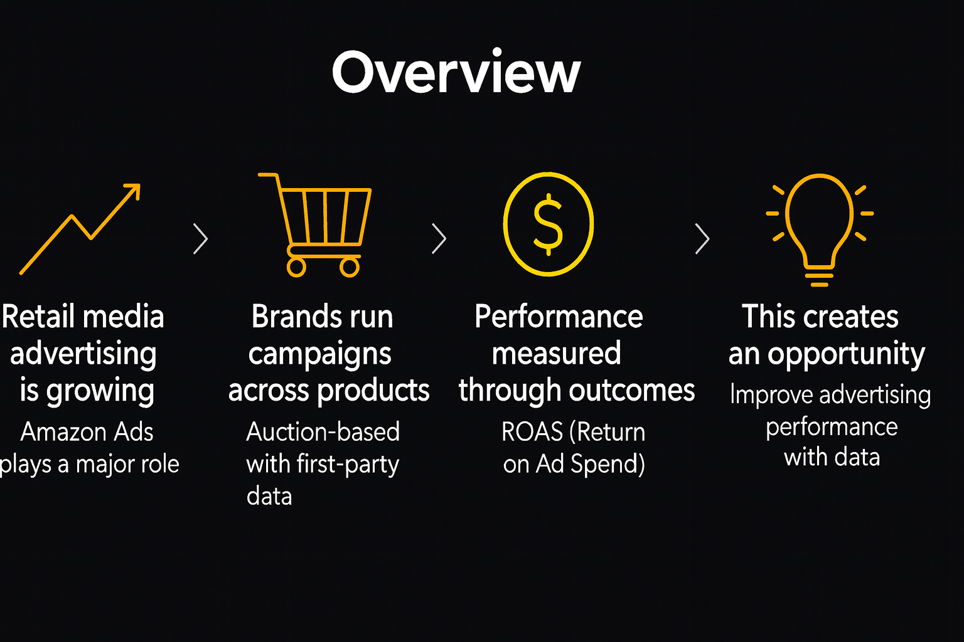
Are Our Ads Paying Off?

Slide 3
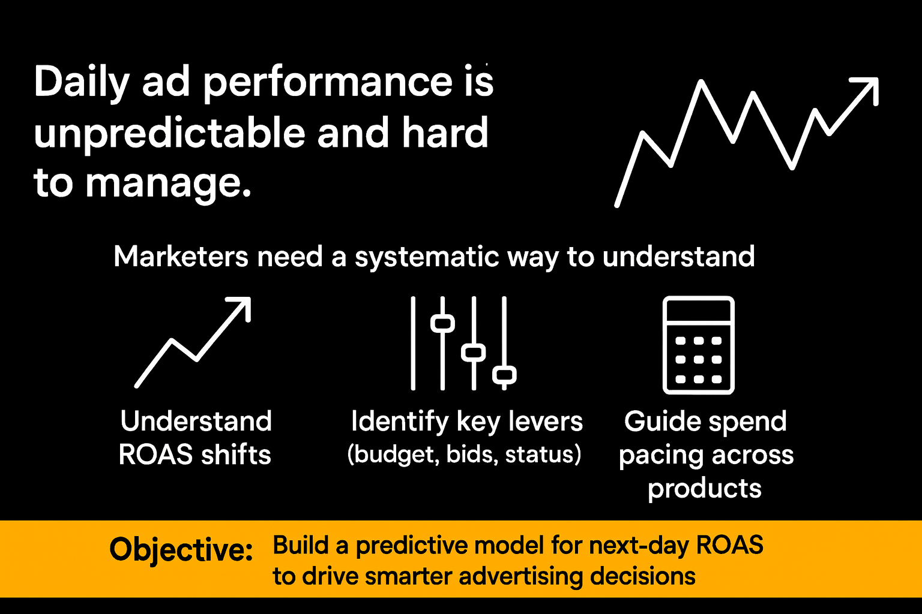
The Ad Spend Problem

Slide 4
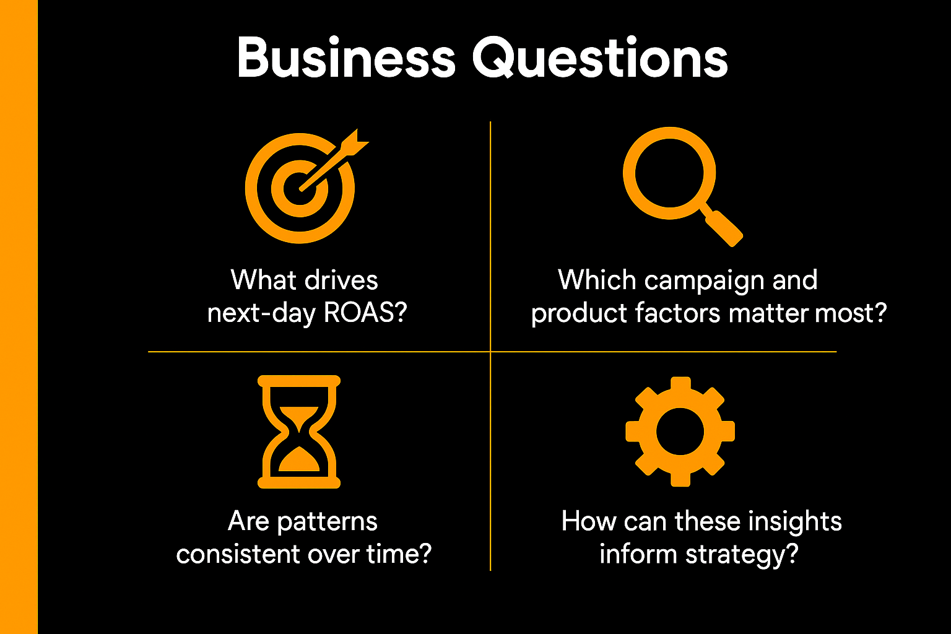

Slide 5
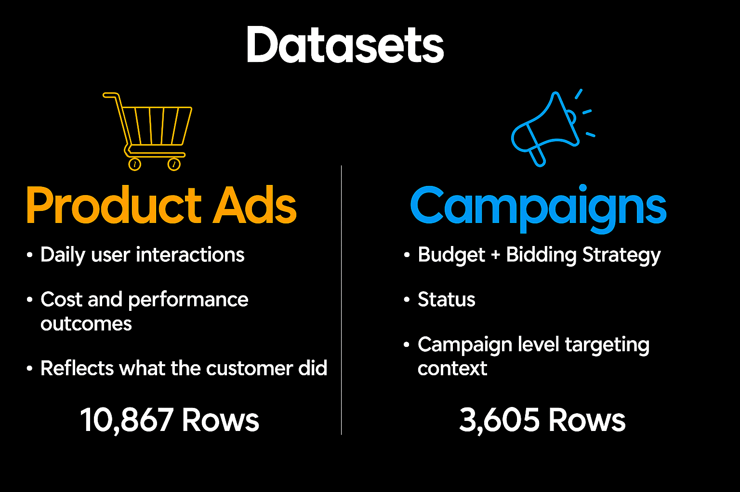

Slide 6

Key Variables
Independent Variables:
Product Ads: Conversions (14-day) & Attributed sales (14-day)
Campaign: Impressions, Clicks, Cost, CTR (Clicks/Impressions), CVR (Conversions/Clicks), CPC (Cost/Clicks)
Dependent Variable: ROAS (Revenue/Cost)

Slide 7
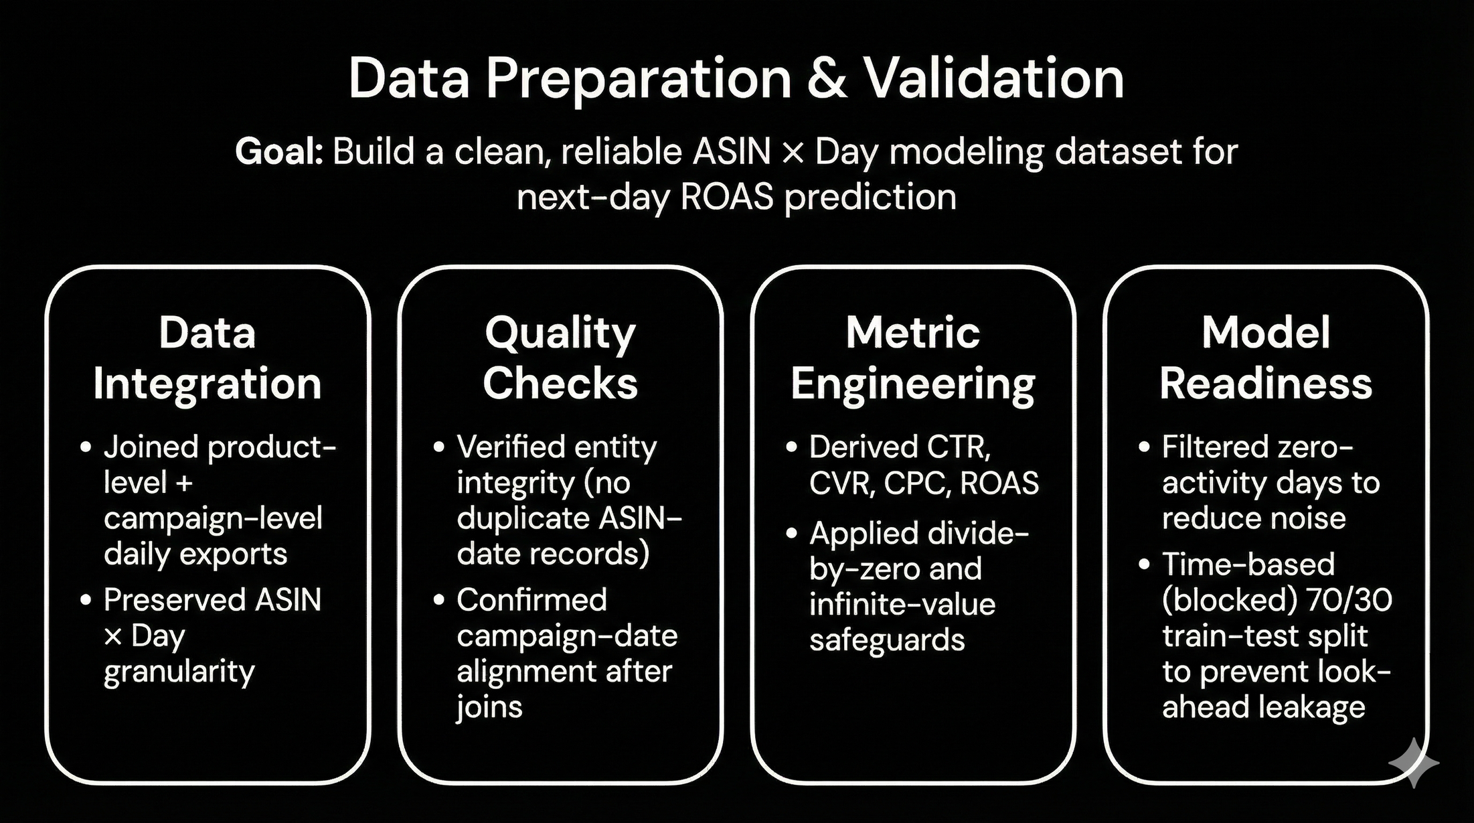
Data Preprocessing

Slide 8
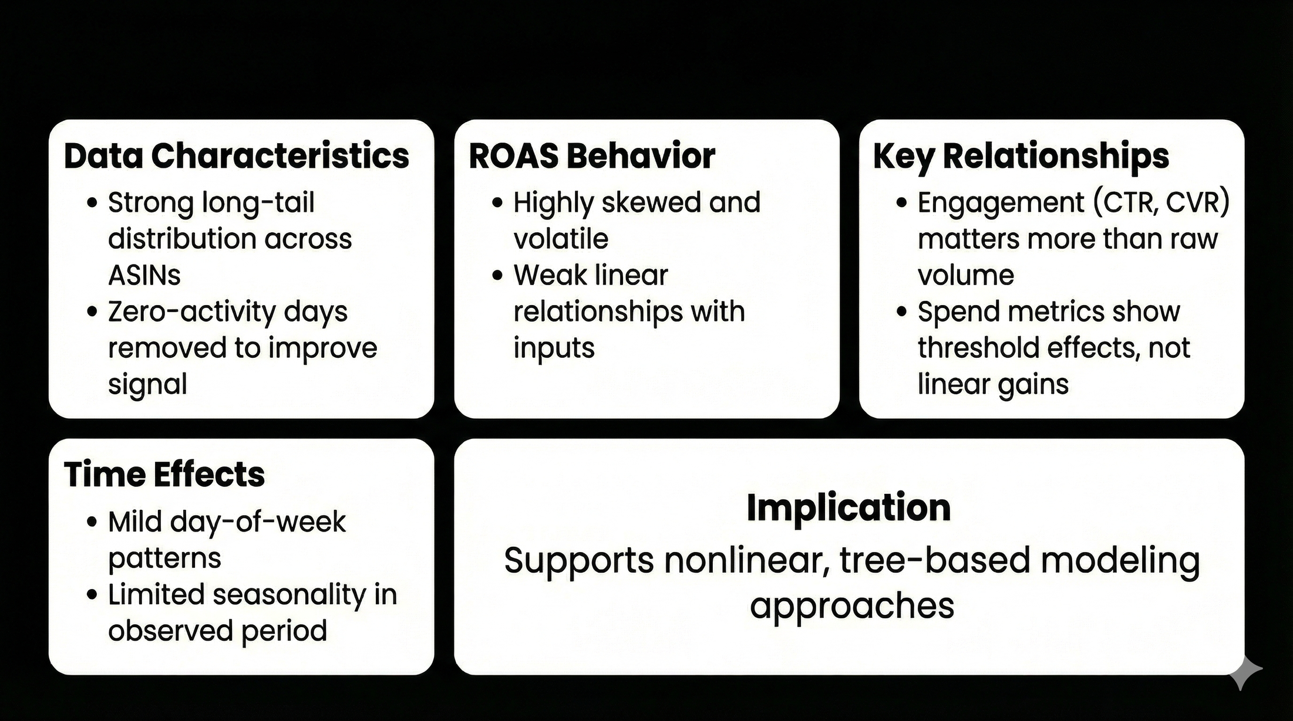
EDA Highlights

Slide 9
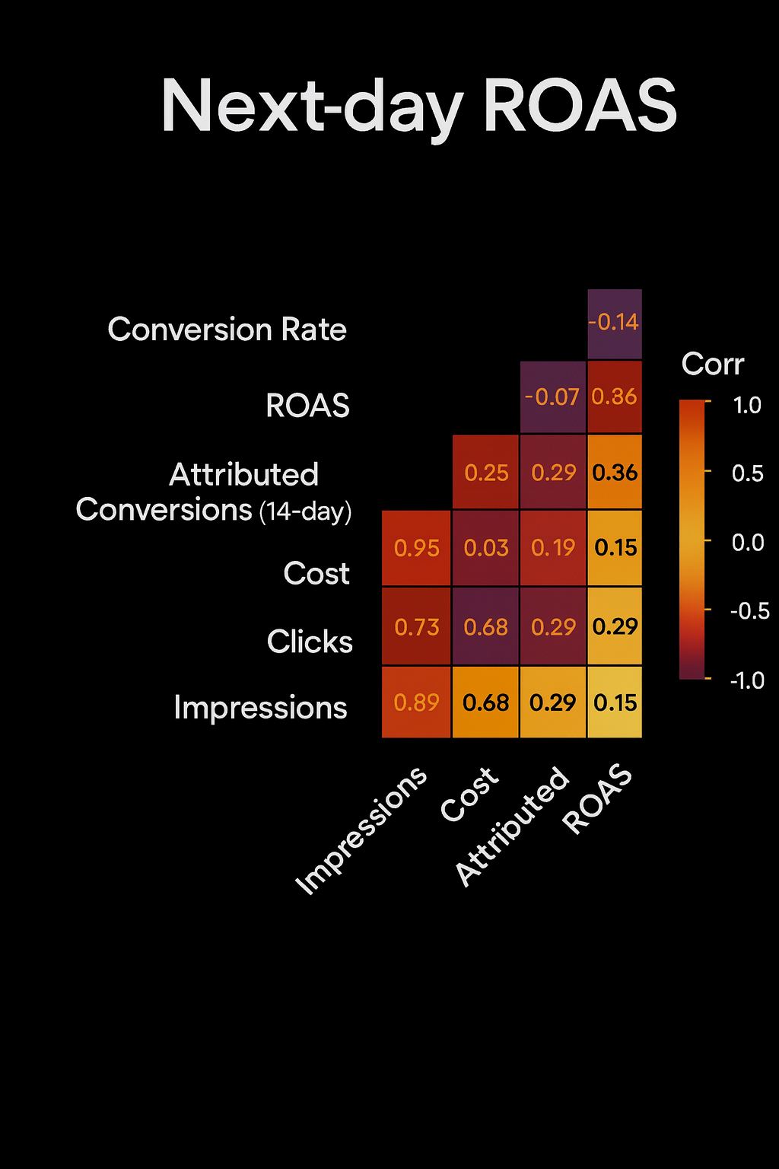
Correlation Matrix of Key Variables

Slide 10
Summary Stats - Train vs Test
Metric | Train - Mean | Train - SD | Test - SD | Test - Mean
Impressions | 5,130 | 14,257 | 20,894 | 4,626
Cost ($) | 30.2 | 65.5 | 71.4 | 25.9
CPC ($) | 2.49 | 2.37 | 2.18 | 2.21
ATB Conversions | 2.1 | 4.9 | 6.8 | 2.3
ATB sales ($) | 58.9 | 140 | 157 | 61.5
CVR | 0.17 | 0.35 | 0.36 | 0.18
ROAS | 4.5 | 23.5 | 34.9 | 4.7

Slide 11
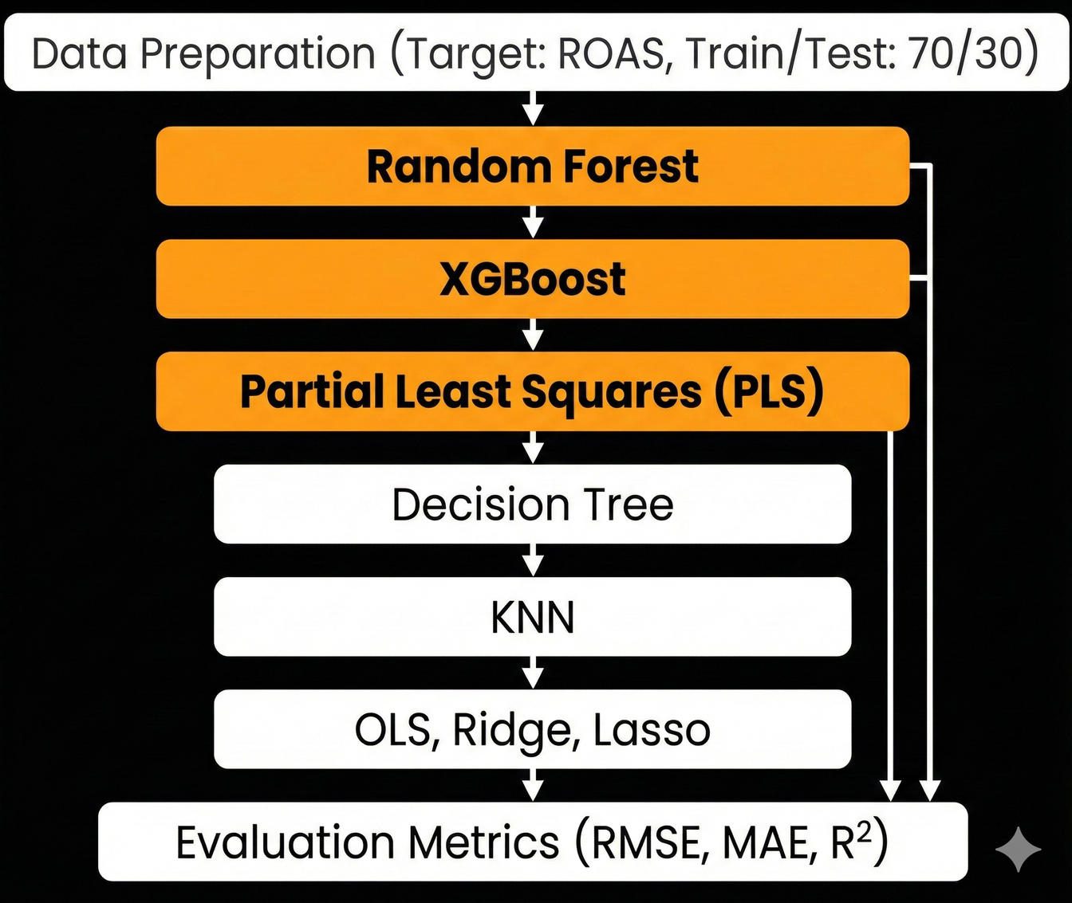
Modeling Methodology
Target Variable: ROAS, Time Based Partitioning: Train/Test, 70/30

Slide 12


Model Comparison
XG Boost
Random Forest
Partial Least Squares
(log ROAS)
RMSE: 18.2
RMSE: 23.02
RMSE: 0.55*
MAE: 1.91
MAE: 1.55
MAE: 0.39*
R² : 0.87
R² : 0.86
R² : 0.73*
* PLS metrics are log-transformed.

Slide 13
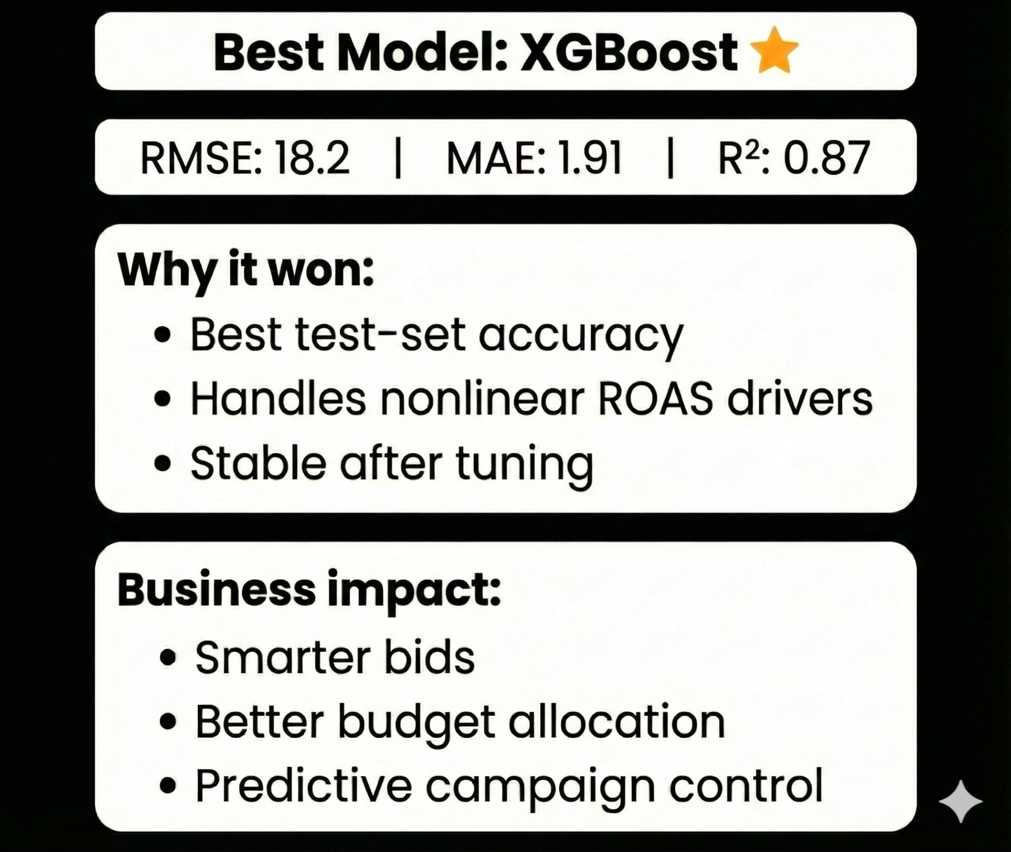

Slide 14
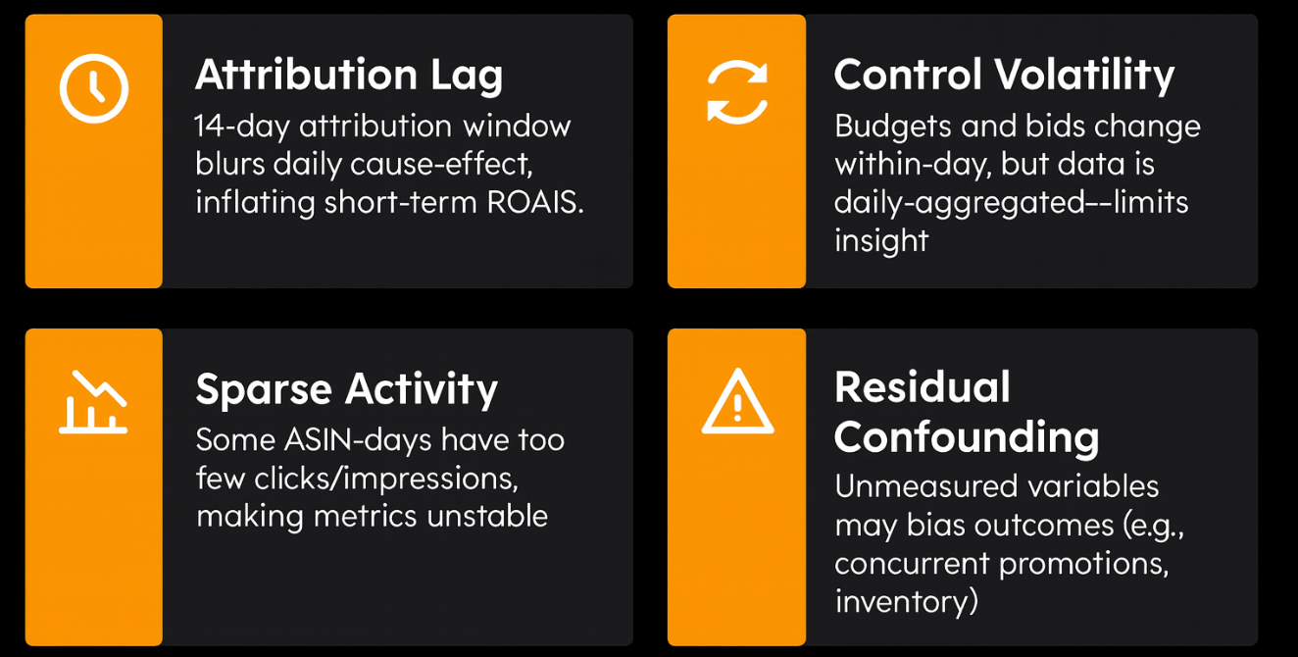
Limitations & Risks

Slide 15
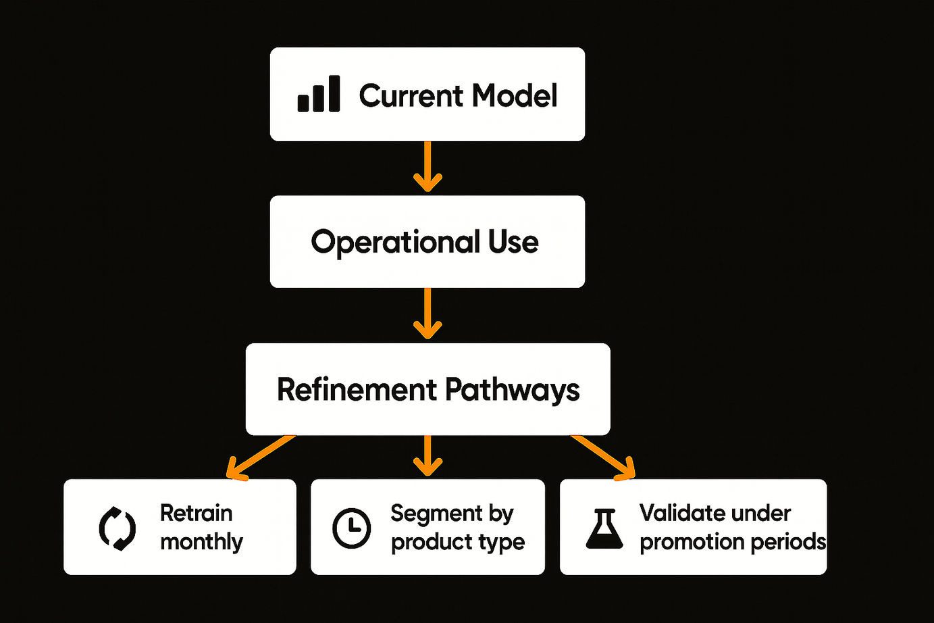
Strategic Recommendations & Next Steps

Slide 16
Thank You

Slide 17
Appendix

Slide 18
ROAS (Return on Ad Spend): Revenue divided by cost, using 14-day attributed sales. Represents how many dollars of revenue are generated for each dollar spent on ads.
Attributed Conversions (14-day): Number of purchases credited to an ad if they occur within 14 days after someone clicks the ad.
Attributed Sales (14-day): Total revenue from purchases made within 14 days of an ad click.
Impressions: Number of times an ad is displayed to users.
Clicks: Number of times users click the ad.
Cost: Total advertising spend for the campaign on a given day.
CTR (Click-Through Rate): Clicks divided by impressions; shows how often users who see the ad click it.
CVR (Conversion Rate): Conversions divided by clicks; shows how often clicks result in purchases.
CPC (Cost Per Click): Cost divided by clicks; measures how much each ad click costs.
Budget: Daily or campaign-level spending limit set by the advertiser.
Bidding Strategy: How the platform allocates spend (manual bids, automated bidding, etc.).
Status: Whether the campaign is active, paused, or ended.

Slide 19
